Slide 1
Capstone Project
Team : NYC Taxi Trip Time Prediction Analysis Team Member Kartik Pandey Aniket Nichat Rohit Thawali Aniket Deulkar Sagar Khekale

Slide 2
Content
Data Summary
Analysis Of Data
Challenges
Conclusion

Slide 3
Problem statement
We analysis which month has more trip
We analysis which hour has more trip
We analysis what is the average speed
We analysis how many passenger are in trip with driver

Slide 4
Data Summary
Data set name:-NYC Taxi Data.csv - the training set (contains 1458644 trip records)
The dataset is based on the 2016 NYC Yellow Cab trip record data made available in Big Query on Google Cloud Platform.
Shape :
Rows: 1458644
Columns: 11
Important Columns: [id', 'vendor _id ', 'pickup _ datetime', ‘ dropoff _ datetime', 'passenger _ count', ‘ pickup _ longitude ', ‘ pickup _ latitude', ‘ dropoff _ longitude', ‘ dropoff _latitude', 'store _ and _ fwd _ flag', 'trip _ duration'],

Slide 5
Python Modules/Packages/Libraries.
Let us begin our analysis by loading the above mentioned Python Modules/Packages/Libraries.
pip install haversine
import NumPy as np
import pandas as pd
from NumPy import math
import seaborn as sns
from sklearn.preprocessing import MinMaxScaler
from sklearn.model_selection import train_test_split
from sklearn.ensemble import RandomForestregressor
from sklearn.linear_model import LinearRegression
from sklearn.metrics import r2_score
from sklearn.metrics import mean_squared_error
from datetime import datetime
from sklearn import metrics
from haversine import haversine
import warnings; warnings.simplefilter('ignore')
import matplotlib.pyplot as plt

Slide 6
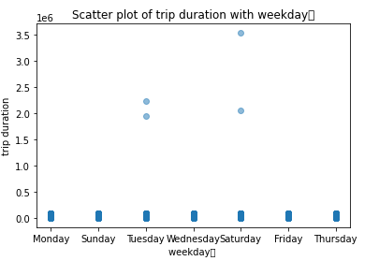
1. Correlation between Independent with dependent
Analysis of Data

Slide 7
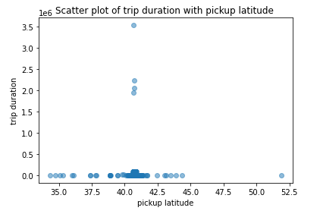

Slide 8
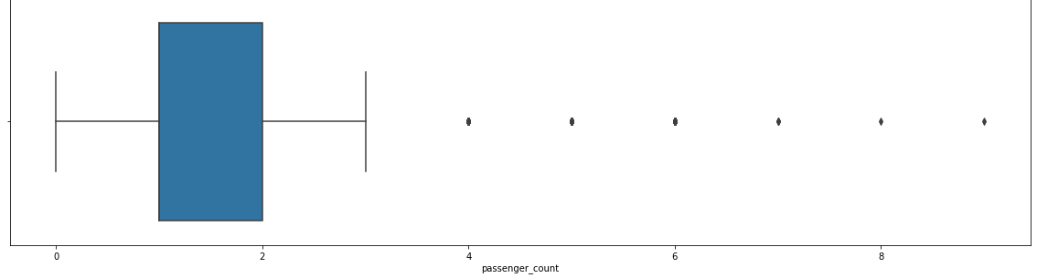
2. Analysis of passenger count

Slide 9
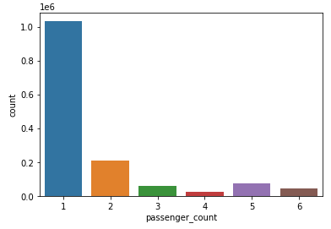

Slide 10
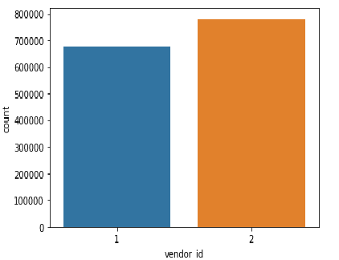
3. Analysis of vendor id

Slide 11
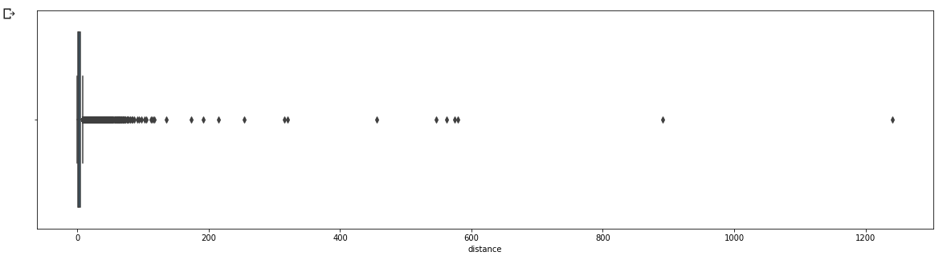
4. Analysis of distance

Slide 12
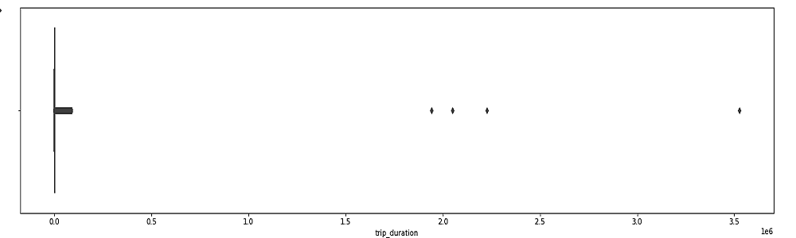
5. Analysis of trip duration

Slide 13
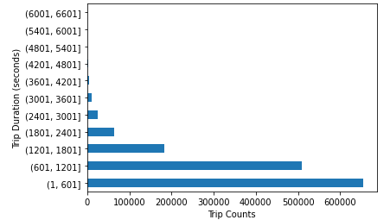
6. Analysis of trip duration with trip counts

Slide 14
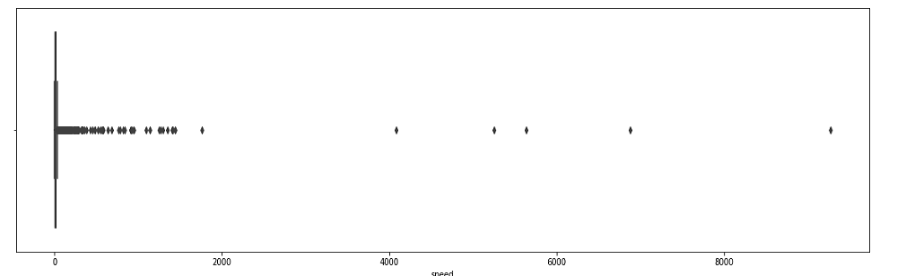
7. Analysis of speed

Slide 15
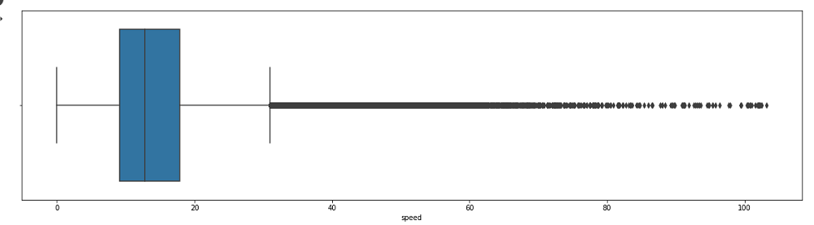

Slide 16
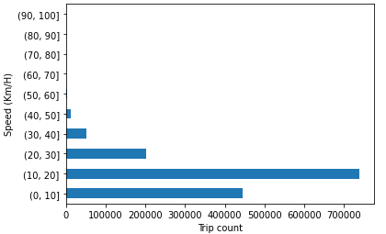
7.1 We take trip count with average speed

Slide 17
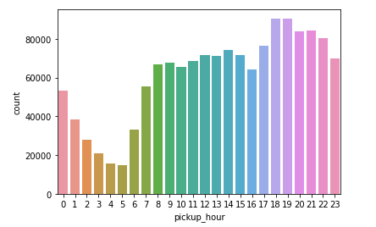
8. Analysis of pickup hour

Slide 18
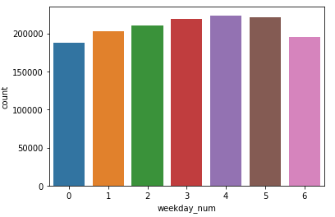
9. Analysis of weekday

Slide 19
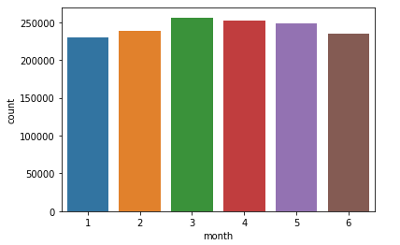
9.1 Analysis of month

Slide 20
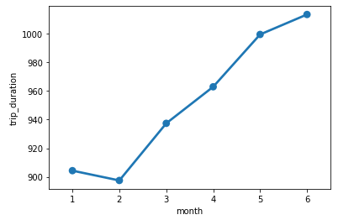
10. Analysis of month with trip duration

Slide 21
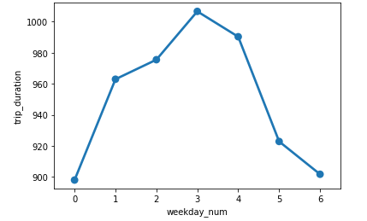
11. Analysis of weekday with trip duration

Slide 22
Challenges
There are huge data set like around 1.5million
We are stuck in how to perfect feature to take train and test split
We cannot do map visualization because the code is not run in cell, using that we can’t see the perfect location because reverse geo coding are not run properly

Slide 23
Conclusion
As we see that in february has not to much trip because of there is no season like wind/summer
It seem in the project in the weekday Thursday has more trip
As we see the most pickup hour start form 6am and after is going on
We see that most of the trip in between 10 to 20 kmph

